Slide 1

WELCOME

Slide 2
INTRODUCTION
MOHAMMAD ROMEZ UDDIN . ID-01
ASSISTANT Teacher (ICT)
B .S.BISWESWARI HIGH SCHOOL
BARARIA. TANGAIL
MOBILE: 01713562621
E-mail: romeztangail@gmail.com

Slide 3
INTRODUCTION OF LESSON
CLASS :EIGHT
Number Of Student: 80
Sub:English 1st paper
Unit:Seven Lesson:3
Time:45 mn Date:07/10/15

Slide 5
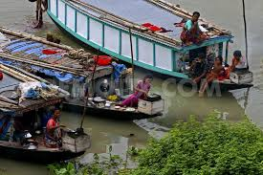
TOPIC
RIVER GYPSIES

Slide 6
OUT COME OF THE LESSON
THE STUDENTS WILL BE ABLE TO………..
1. Recognize the river gypsies,
2. Mention their living places,
3. Describe their life styles,
4. Elicit the reasons of leaving their traditional professions.

Slide 7
LESSON PLAN
SL.NO | STEPS | ACTIVITES | TIME | EQUIPMENT
1 | PREPARATION | Greeting/Arrangements/ Announcement of the Lesson | 5 mn | D.C
2 | PRESENTATION | 1. Showing a video to introduce the topic. | 3 mn | D.C
 |  | 2. Showing a chart of the characteristics of the gypsies get the meaning of some new words, individual work | 4 mn | D.C
 |  | 3. Showing two images to find out the difference between gypsy life and main stream life, pair work. | 12 mn | D.C
 |  | 4. Showing two images to find out the causes of leaving the traditional profession of the gypsies, group work. | 12 mn | D.C
3 | EVALUATION | Showing two images of the conditions of the gypsies. 1. Why don’t the gypsies get some of the basic rights from the state? 2. How can the gypsy people improve their life style? | 6 mn | D.C/ W.B
4 | HOME WORK | Write a paragraph about “River Gypsies.” | 2 mn | D.C/ W.B
5 | COMPLETION | THANKS GIVING. | 1 mn | D.C

Slide 8
Catching and Selling snakes
Snakes Charming
River Gypsy
Professional activities
Selling herbal cures
healing pains by sucking bloods
Selling bangles, cosmetics by the women

Slide 9
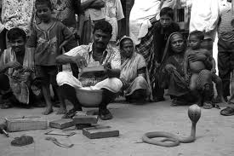
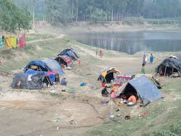
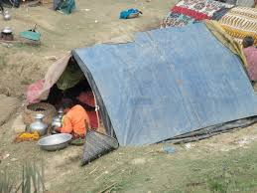
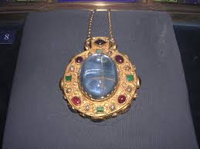
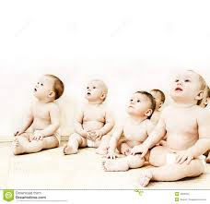
KEY WORDS
th
Ethnic
Different stream from the main stream living in a particular country
A kind of removable shelter with thick cloth
Tarpaulin tent
Talisman
Magical stone to ward off evil
Children,
babies
Toddlers

Slide 10
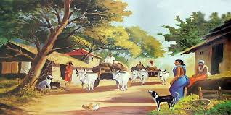
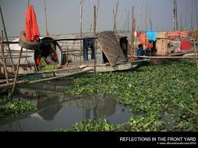
Picture 01
Picture 02

Slide 11
Work in pairs
Find out the differences between main stream people’s life and gypsy life.

Slide 12
WORK SHEET
Some points about the differences ………
Main stream people | Gypsy people
1. Parmanent residence | 1. Temporary residence
2. Resides on the main land | 2. Resides over the watery body
3. Male dominated society | 3. Female dominated society
4. Gets most of the basic rights | 4. Gets some of the basic rights

Slide 13
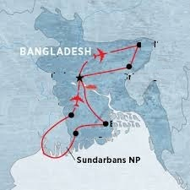
River Gypsy
Sylhet
Srimangal
Dhaka
Jessore
Barisal
Mongla
Gipsies’ living place in Bangladesh

Slide 14
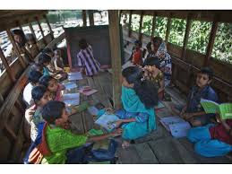
GROUP WORK
Picture--1
Picture--2
Look at the pictures and discuss about them in groups. Point out the causes of leaving the traditional profession of the river gypsies.

Slide 15
WORK SHEET
Some reasons of leaving the traditional profession are……
1. Drying out of rivers
2. Restriction of boat movement
3. Changing attitude among themselves towards the profession
4. Loss of interest to the profession
5. Unwillingness of the young generation to the profession

Slide 16
EVALUATION
1. Why don’t the gypsies get some of the basic rights from the state?
2. How can the gypsy people improve their standard of livelihood ?

Slide 17
HOME WORK
Write a paragraph about
“River Gypsies”

Slide 18

THANKS A LOT.

